Slide 1
MOVIE RECOMMENDATION SYSTEM

Slide 2
TEAM MEMBERS
T.Niranjan -9921004732
T.Saketh -9921004706
T.Shantan -9921004711
T.Harshavardhan -99210041292
T.Sasi kumar -9921004714

Slide 3
INTRODUCTION
A Recommendation is a system that provides to user for certain resources like books, movies, songs, etc, based on some dataset.
The system can be recommend movies based on one or a combination of two or more attributes.
Movie recommendation system can suggest a set of movies to users based on their interest of the people or the popularities of the movies.
A Movie recommendation system, or a movie recommender system is an ML based approach to filtering or predicting the users film preferences based on their past choices and behavior.

Slide 4
ABSTRACT
The Recommendation system uses filtering, clustering techniques such as cosine similarity and tf-count vectorizer to suggest recommendations.
The movie recommendation system usually predicts movies that are similar to their searches.The recommendation system is beneficial,for people as they decrease,the wasting of time deleting movies from a Huge list.
A lot of factors can be considered while designing a movie recommendation system like the genres of the movie ,actors present in the movie and even the directors of the movie. Thus dataset used for the Movie recommendation system is the movie lines dataset. The data analysis tool used in Python.

Slide 5
SURVEY-1
S.No | AUTHOR | JOURNALS/ CONFERENCE | PUBLISHER | PUBLISHED DATE | DESCRIPTION
1. | SUDHANSHU KUMAR PARTHA PRATHIM ROY KANJAR DEJ | JOURNALS | IEEE | 28-5-2020 | The purpose to use movie tweets is to understand the current trends, public sentiment, and user response of the movie. Researchers have proposed several optimization algorithms, such as gray wolf optimization artificial bee colony particle swarm optimization and genetic algorithms.

Slide 6
SURVEY-2
S.No | AUTHOR | JOURNALS/ CONFERENCE | PUBLISHER | PUBLISHED DATE | DESCRIPTION
2. | RAGHAV MEHTA SHIKHA GUPTHA | JOURNALS | ACADEMIA | 01-01-2021 | Recommendation Systems into picture to guide users towards the information according to their preferences. In context of Recommendation of Movies and TV shows on Online Streaming platforms ,this paper is aimed to explain making and implementation of Movie Recommendation Systems Using Algorithms, Sentiment Analysis and Cosine Machine Learning Similarity. In Kaggle and other is user tweets from MovieTweetings database.

Slide 7
SURVEY-3
S.No | AUTHOR | JOURNALS/ CONFERENCE | PUBLISHER | PUBLISHED DATE | DESCRIPTION
3. | ANMOL CHAUHAN DEEPANK NAGAR PRASHANT CHAUDHARY | CONFERENCE | IEEE | 05-04-2021 | Recommendation systems are the most important intelligent systems that plays in giving the information to the users. Content based filtering with sentiment analysis of movies algorithm is used.

Slide 8
SURVEY-4
S.No | AUTHOR | JOURNALS/ CONFERENCE | PUBLISHER | PUBLISHED DATE | DESCRIPTION
4. | R LAVANYA B BHARATHI | CONFERENCE | ACM DL DIGITAL | 12-04-2021 | Hybrid Movie Recommendation System using sentiment analysis with opinion mining, is a system that helps the user by giving recommendations about the movies, based on the user preference and ordinal ratings of the movies. It removes the need for the user to go through a big list of movies before deciding what should be watched It gives the best accuracy and highest precision values using Logistic Regression (LR) and lowest recall value as compared to other algorithms

Slide 9
SURVEY-5
S.No | AUTHOR | JOURNALS/ CONFERENCE | PUBLISHER | PUBLISHED DATE | DESCRIPTION
5. | ZAN WANG NAN FENG XUE YU | JOURNALS | SCIENCE DIRECT | 14-10-2014 | For media product, online collaborative movie recommendations make attempts to assist users to access their preferred movies by capturing precisely similar neighbors among users or movies from their historical common ratings.which utilizes the improved K-means clustering coupled with genetic algorithms (GAs).The experiment results on Movielens dataset indicate that the proposed approach can provide high performance in terms of accuracy.

Slide 10
PROPOSED SYSTEM
In our model we recommend the movies similar to genre and rating of the particular movie that user has selected.
To implement this we have used tfvectorization(key word extraction) and cosine simailarity.
Tfvectorization fit the genre and rating that implies it map the most frequent words into matrix.
Cosine similarity helps to find the similarity between the movies and recommend the movie for the user based on his/her selection.
In this way we recommend the movie for the user.

Slide 11
ALGORITHM
Import required packages.
Using pandas read the two datasets movies and credits.
Check for null values and perform EDA
Using ast module dict keys like generes,cast,language is separated and assigned to new columns with the name as keys.
After separation of columns we combined all those columns except movie id and assigned it to a new column

Slide 12
ALGORITHM
We vectorized every row in newly framed column
Using cosine similarity function we applied the similarity to every vectorized value
For new inputed movie we check whether the movie is in our database and if it is present it is vectorized and check for top 5 similarities.
Those movies along with cast&crew, movie plot with pictures and recommended movies were displayed using webscraping(streamlit)

Slide 13
FLOW CHART
IMPORTING DATASET
EXPLANATORY DATA ANALYSIS
FEATURE ENGINEERING
VECTORIZING COLUMNS
FINDING THE COSINE DISTANCE
RECOMMENDING MOVIES

Slide 14
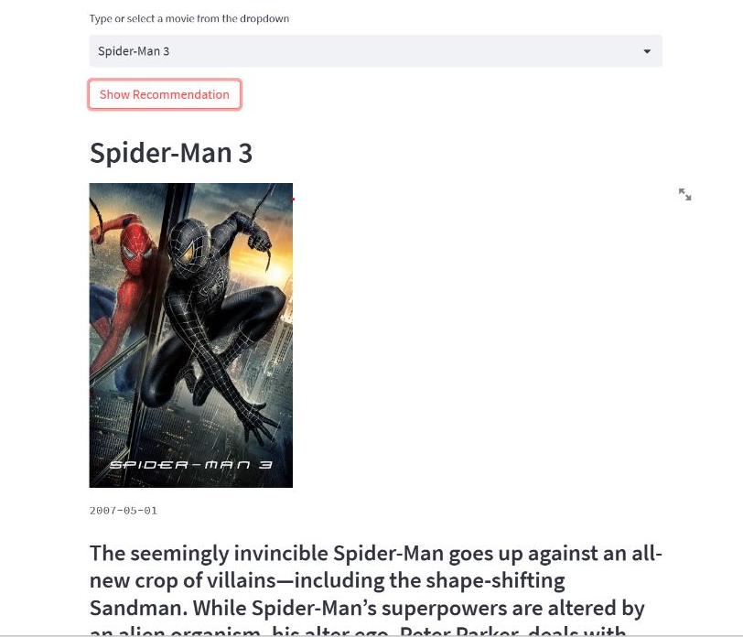
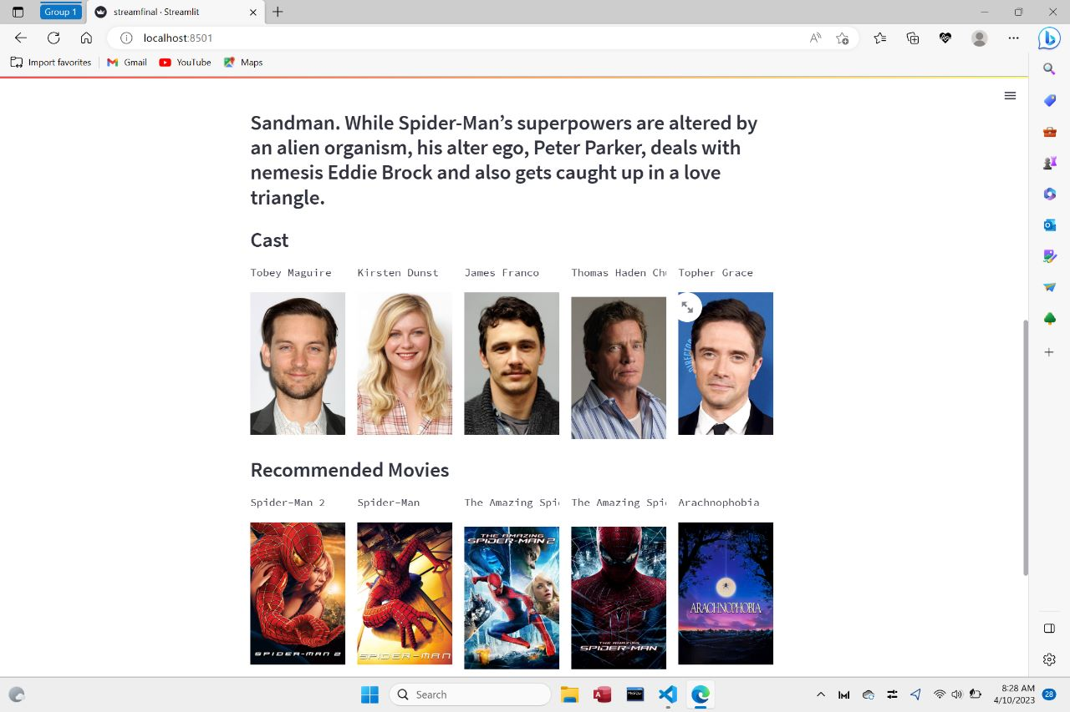
SCREENSHOTS OF OUTCOMES

Slide 15
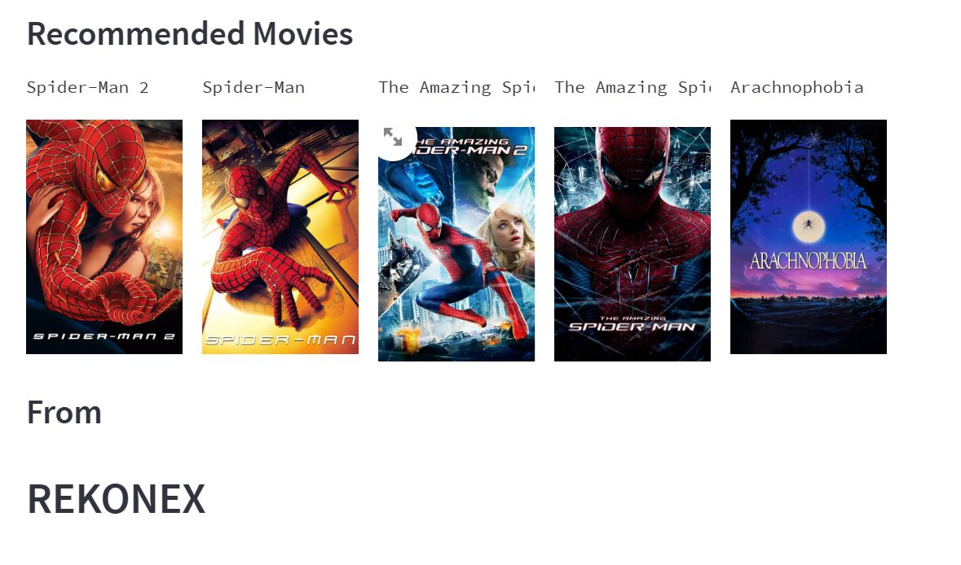
SCREENSHOT OF OUTPUT

Slide 16
CONCLUSION
This algorithm is for cooperative filtering recommendation system and applied it in the movie recommendation system.
This individual recommendation system uses the singular value corruption algorithm and User-based co-coin similarity algorithm; these recommend the top pictures to the active User.
We used cosine similarity to calculate the similarity between the movies.
By the cosine similarity our model recommend the movies for the user.

Slide 17
REFERENCES
[1] Sudhansu kumar and Partha Prathim roy and Kanjar de—Journals—IEEE— 28th may 2020.
[2] Raghav mehtha and Shiksha Guptha—Journals—Academia—1st January 2021.
[3] Anmol Chauhan and Deepak nagar and Prashant Chaudhary—Conference— IEEE—5th April 2021.
[4] R Lavanya and B bharathi—conference—ACM DL DIGITAL—12th April 2021.
[5] Zan wang and Nan Feng and Xue yu—Journals—SCIENCE DIRECT—14th October 2014.

Slide 18
THANK YOU

